Slide 1

NeMo : Network Admin Tool
Student Name : Himanshu Gupta
Shivam Mishra
Utkarsh Shrivastav
Branch/Sem : IT/8th Project Guide
Session : 2014 – 2018 Swati Ma’am

Slide 2
Index
Introduction
Existing System
Proposed Model
Self Spreading Layer
Payload Layer
Mertis & Demerits
Conclusion
Future Scope

Slide 3
Introduction
A software to manage multiple nodes in a LAN
Two Layer Architecture
No Client Interection needed
Fully Automated and Plugins Friendly
Can be used to monitor or control specific or all computers
Usefull in Managing Computer Labs Where Active Monitoring of Nodes are needed.

Slide 4
Existing System
No Automated Software is being used.
Teachers and staff has to monitor every system manually or by CCTV.
Logs are in place but they are passive monitoring tool.
Takes time and energy to find a single process that can be running in a single host.

Slide 5
Proposed System
JAVA Based network tool
Can actively monitor and keep track of any system in network.
Single point access to all nodes via a user friendly GUI.
Works without client side interection.

Slide 6
Layer 1
Used to spread and excute any program on any number of host in a network without client side interection.
Anything can be used as payload
Remote admin, DOS, JAVA Front End Used

Slide 7

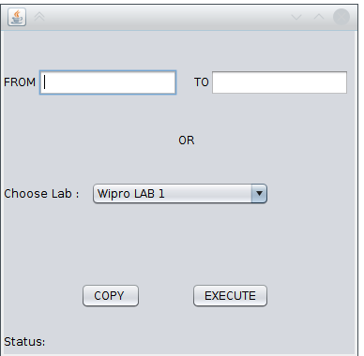

Slide 8
Layer 2
JAVA Based Payload
Socket Programing
Multiple Tools
Great Control Without Permission and Client Access Issue
More Plugins can be supported

Slide 9
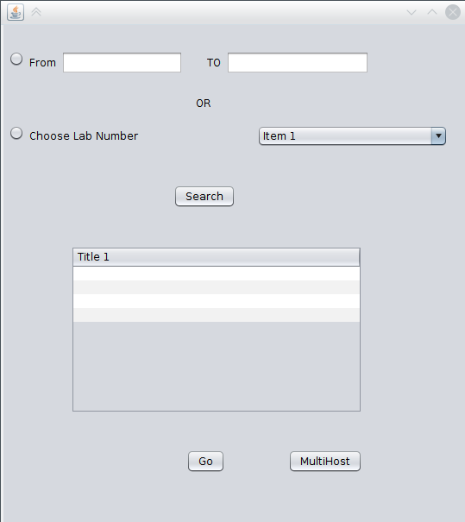
Homepage Snap

Slide 10
Single Host Operations
Screen Share
Mouse Control
Process Monitoring
Remote Shell
Pop up Messages

Slide 11
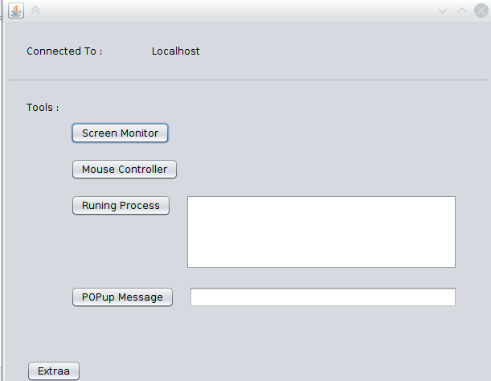
Single Host Panel

Slide 12
MultiHost Controls
Change Wallpaper
Search Process
Beep Sounds
Popup Messages

Slide 13
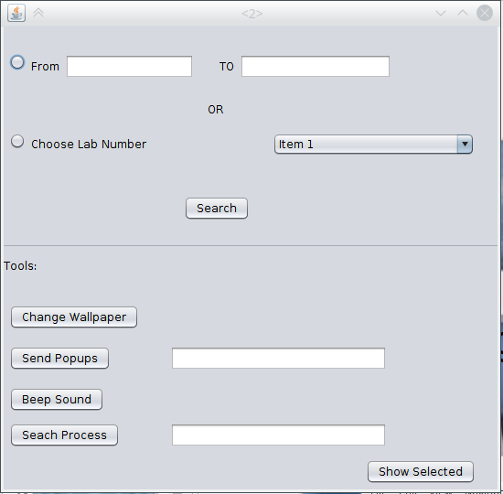
Multtihost Control Panel

Slide 14
Merits & Demerits
Monitoring is Easy
Multiple Tool in one app
Based on Java
Easy to add plugin
Complex to setup
Need JRE in systems

Slide 15
Conclusion
First Gen Product for Lab Monitoring
Can give high amount of access to teachers an lab assistents
Easy to use front end UI
Need of the hour

Slide 16
Future Scope
Can be used for implementing client less programs.
Dapps can take full advantages.
With improvments can be applied in any lan
Multiple payload server distribution.

